Slide 1


Preventing Human-Bear Conflict with Behavioural Insights
HWC Discussion March 31, 2025

Slide 2
Collaborators and Support
The University of British Columbia
Sumeet Gulati
David J. Hardisty
Cole Burton
Rumi Naito
Sima Khanal
Agamveer Kalra
Raunaq Nambiar
BC Parks
Don Carruthers Den Hoed
Sharilynn Wardrop
Melanie Percy
Erin Kendall
Park Managers
Troy Davis, Manning Park
Ryan Turral, Cultus Lake
Michael Zavaglia, Cultus Lake

Slide 3
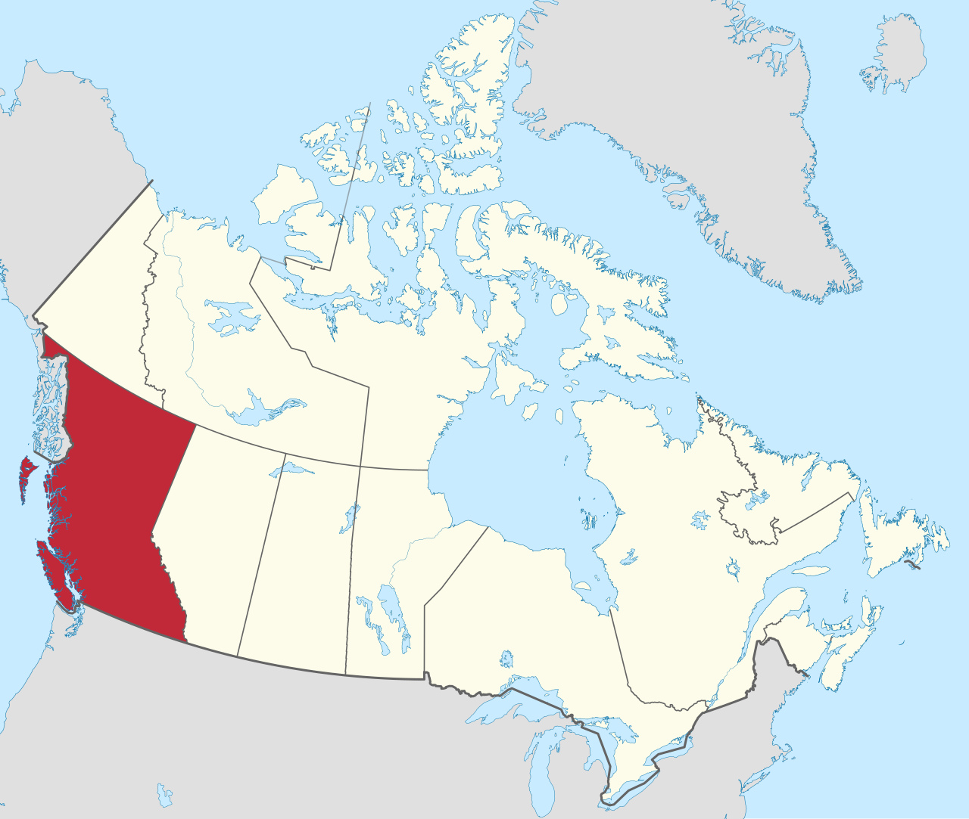
Lands
UBC Vancouver Campus
Musqueam
Squamish
Tsleil-Waututh
Manning Park
Stó:lō
Similkameen
Cultus Lake
Ts'elxwéyeqw
Soowahlie

Slide 4
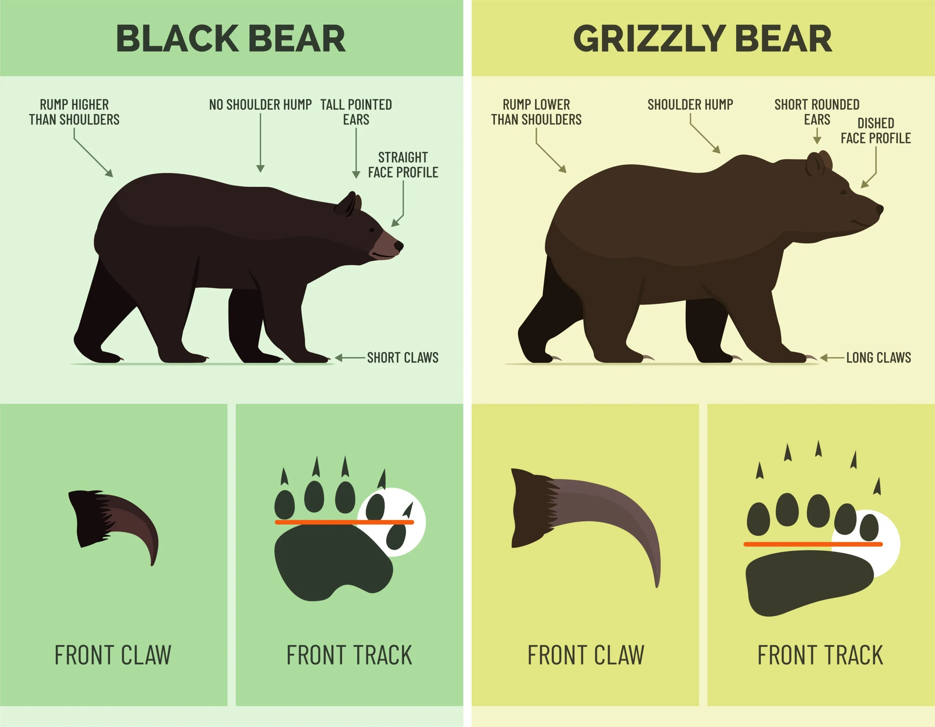
Black Bears vs Brown Bears
Notes:
Image from https://www.fieldandstream.com/conservation/black-bear-vs-brown-bear
also posted at https://www.bearsmart.com/about-bears/know-the-difference

Slide 5
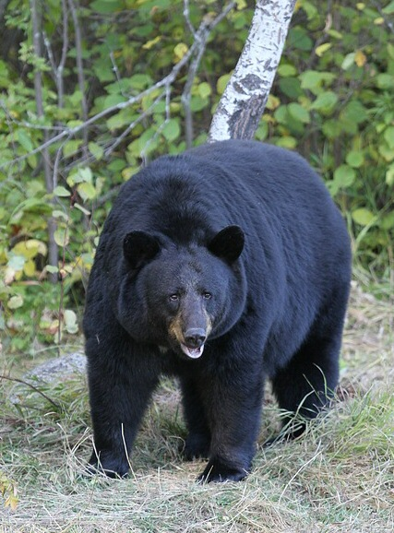
Human Bear Conflict: The Problem
Humans are increasingly encroaching on bear habitat (exacerbated by climate change)
Food and food odours attract bears, leading to conflict and the death of the bear
Typically 500 bears are killed each year in BC
It is generally illegal to leave out bear attractants at campgrounds and homes near bear habitats, but people still do it (i.e., policy solution is in place, but not enough compliance). B.C.’s Wildlife Act Sections 33.1, 88.1, 84, 84.1
Notes:
In the province of British Columbia, it is an offence to feed dangerous wildlife e.g., bears, cougars, coyotes, and wolves, or to disobey orders to remove and clean up food, food waste, or other substances that can attract dangerous wildlife. Refer to B.C.’s Wildlife Act Sections 33.1, 88.1, 84, 84.1 for more information.
Image from https://en.wikipedia.org/wiki/American_black_bear#/media/File:01_Schwarzb%C3%A4r.jpg
CC BY-SA 3.0
https://bear.org/bear-facts/black-bear-color-phases/
Black bears can be black, brown, cinnamon, blond, blue-gray, or white.

Slide 6
Behavioural Insights Approach
Applying social science research (such as psychology and economics)
to encourage better choices for individuals and society
often used in public policy
Example: using defaults to increase household uptake of green energy
One framework is E.A.S.T. (BIT 2014). Make the behaviour:
Easy
Attractive
Social
Timely
Behavioural Insights Team (2014). East. Four Simple Ways to Apply Behavioural Insights.

Slide 7
Research Question
What is the most effective way to improve human behavior and decrease unattended bear attractants?
Additional information?
Financial incentive? ($10 gift card to Tim Hortons)
Social nudge? (responsible camper sticker)

Slide 8
Research Design
Condition 1 (C1): Control
Consent form and agree to be observed.
No additional intervention provided.

Slide 9
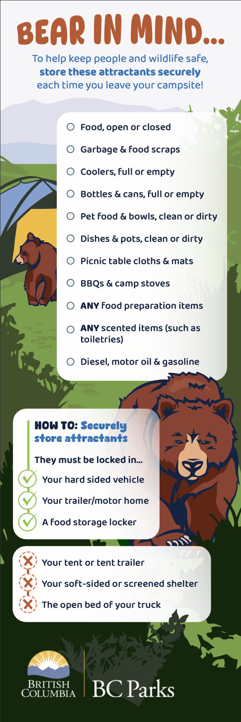

Research Design
Condition 2 (C2): Information only
Provide campsite visitors with a card containing information on bear-safe behaviors and a list of bear attractants that should be avoided.

Slide 10

Research Design
Condition 3 (C3): Information + Financial incentive
Provide campsite visitors with a card and offer a cash reward if they maintain a “bare” campsite

Slide 11

Research Design
Condition 4 (C4): Information + Sticker
Provide campsite visitors with a card and offer a “responsible camper” sticker as a reward if they maintain a “bare” campsite

Slide 12
Research Design
Interventions given to campers by our research assistants, visiting campers as they arrived throughout the day (N=257 campsites)
Data on bear attractant behavior collected by research assistants via observation each morning
Key outcome: Attractant violations (rated 0, 1 ,or 2)
Violation Score | Description
0 - No violations | No attractants recorded.
1 - Moderate Violations | At least one but no more than 3 attractant category violations observed, AND no severe attractant category (Food and Food Scraps, Garbage) violation observed.
2 - Severe Violations | 3 or more attractant category violations observed, OR at least one severe attractant category violation observed.

Slide 13
Research Design
Condition 1 (C1): Control
Condition 2 (C2): Information only
Condition 3 (C3): Information (C2) + Financial incentive
Condition 4 (C4): Information (C2) + Sticker
Your prediction? Which condition is most effective for reducing violations?

Slide 14
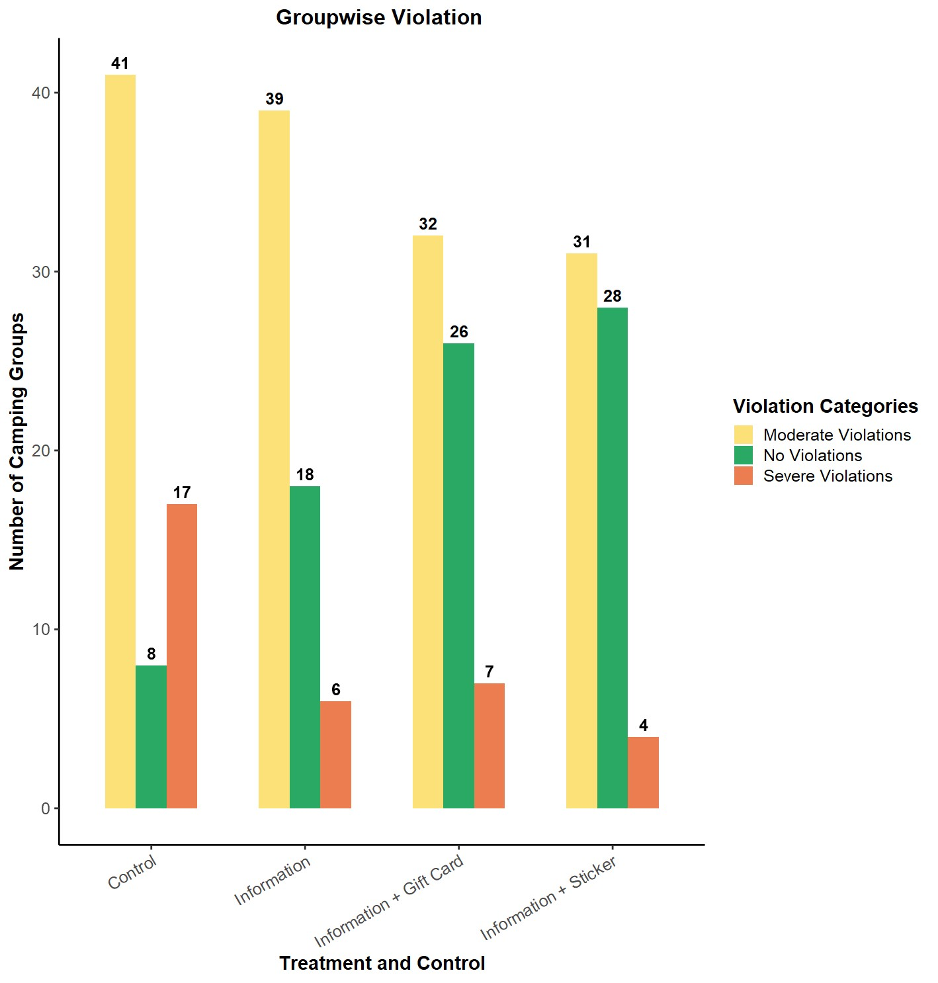
Results

Slide 15
Results

Slide 16
Results
Control Group: The Control group had the highest mean violation score (1.30)
Information Group: 34% reduction compared to the Control group.
Information + Gift Card Group: 44% reduction compared to the Control group.
Information + Sticker Group: 50% reduction compared to the Control group, achieving the lowest average score.

Slide 17
Anecdotal Result
We did not collect any data on camper demographics, but our research assistants noticed something:
The sticker condition seemed to be especially effective among families with children

Slide 18
Study 1: Key Takeaways
Improved information, detailing exactly what to do and how to do it, improves camper behaviour
Financial and/or sticker incentives may help a bit more

Slide 19
Next Steps
Testing again this summer at Cultus Lake, with:
Scalable interventions (no discussion with campers) & larger sample size
Include a true “business as usual” control (no consent form)
Two survey questions on how often & why they visit
Collect observational data on camper demographics (number of adults and number of kids)

Slide 20
Thank you!

Slide 21
Bonus Slide: Additional Results
Tukey's HSD Test Results
Comparison | Mean Difference | Lower CI | Upper CI | Adjusted p-value
Information vs. Control | -0.439 | -0.750 | -0.127 | 0.0019
Information + Gift Card vs. Control | -0.563 | -0.872 | -0.253 | <0.0001
Information + Sticker vs. Control | -0.645 | -0.957 | -0.333 | <0.0001
Information + Gift Card vs. Information | -0.124 | -0.437 | 0.189 | 0.7341
Information + Sticker vs. Information | -0.207 | -0.522 | 0.109 | 0.3288
Information + Sticker vs. Information Gift Card | -0.082 | -0.395 | 0.231 | 0.9043

Slide 22
Bonus Slide: Additional Results

